Slide 1
Purpose
This Amplitude Modulation (AM) transmitter supposed to capture ambient Wi-Fi signal using a power harvester. Also, this device will amplify and transmit the signal into a receiver.
Low Power communication.
Antenna (Receives Ambient Wi-Fi)
Battery
Antenna ( Transmits a 10MHz Modulated Signal)
Power Harvester (VDC)
Oscillator (Generates the 10MHz signal)
Matching Network (For AM Modulation
Amplifier
Control Signals for the switch

Slide 2
Notes
Find a bandpass filter (Set the proper bandwidth)
Place the transmitter inside a faraday cage, so there’s no interference from other signals.
Finegrade or coursegade switching
Switch capacitor arrangements or a manual switch
Audio amplifier (High frequency) or a multistage amplifier or opamp
Modulator (Emitter follower circuit)

Slide 3
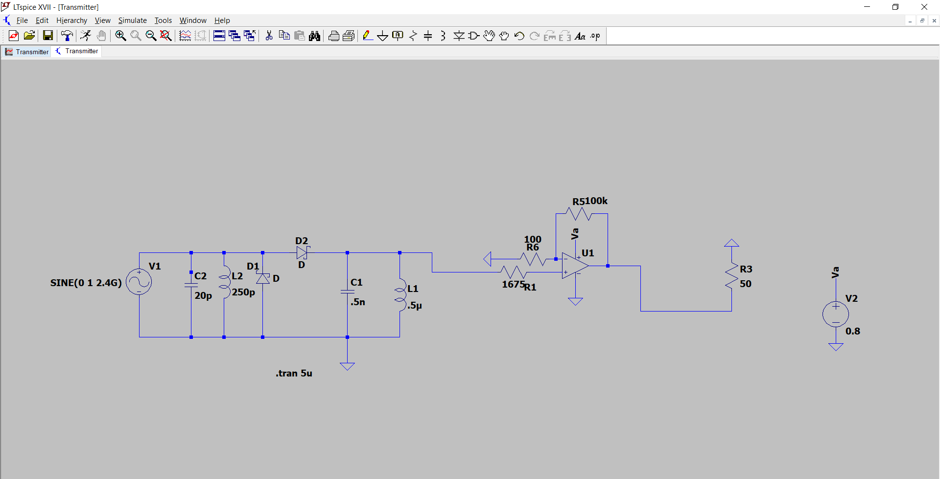
AM Transmitter Schematic

Slide 4
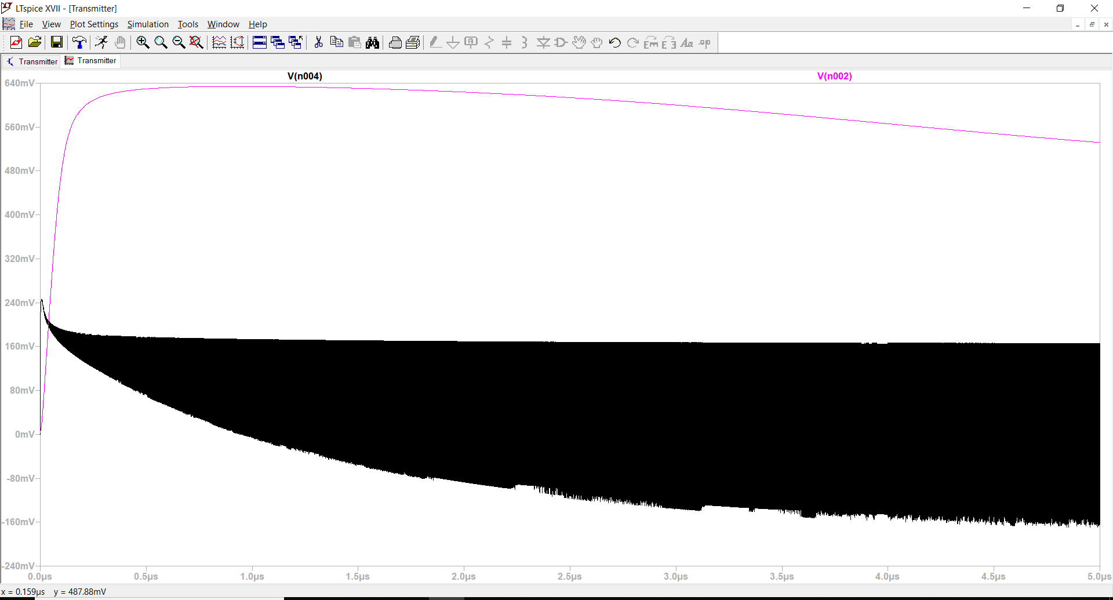
AM Transmitter Signal

